Slide 2
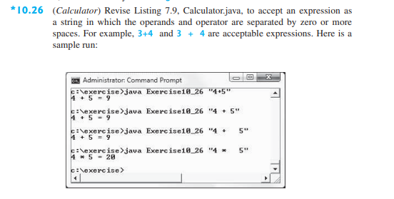

Slide 3
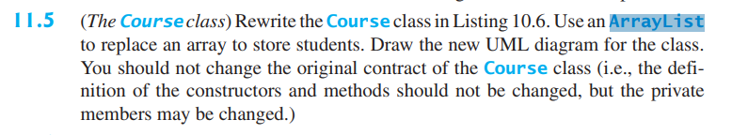

Slide 4
Course
- courseName: String - students: ArrayList<String>
+ Course(courseName: String) + addStudent(nameStudent: String): void + getStudents(): String[] + getNumberOfStudents(): int + getCourseName(): String + dropStudent(String nameStudent): void + clear(): void

